Slide 1




Project
NETWORK INTRUSION DETECTION USING MACHINE LEARNING

Slide 2



Introduction
Network security is a crucial concern in today's world, as organizations increasingly rely on computer networks to store and transfer sensitive data.
Network intrusion is a significant threat to the confidentiality, integrity, and availability of network resources.
Traditional intrusion detection systems (IDSs) have been used to identify potential network attacks, but these systems suffer from several limitations, such as high false positive rates and the inability to detect unknown attacks

Slide 3




Slide 4
Machine learning for network intrusion detection:
Decision Tree: This model builds a tree-like structure where each internal node represents a decision based on the feature values, and each leaf node represents a class label. Decision trees are easy to interpret and visualize, but they may overfit the training data and have limited generalization ability.
K-Nearest Neighbors (KNN): This model classifies an instance based on the class labels of its K?nearest neighbors in the feature space. KNN can be effective for small datasets, but it may be sensitive to the choice of K and the distance metric.
Logistic Regression: This model models the probability of an instance belonging to a particular class using a logistic function. Logistic regression can handle linear and nonlinear relationships between the features and the class labels, but it may suffer from the curse of dimensionality

Slide 5
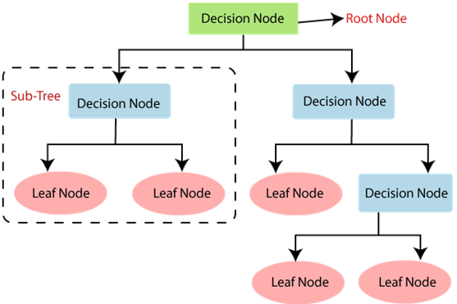
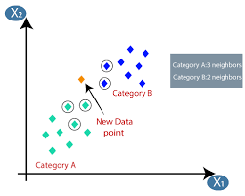

Slide 6
Performance evaluation metrics
Performance evaluation metrics are essential in network intrusion detection systems to assess the effectiveness of the models in detecting network intrusions. Here are some commonly used metrics:
Accuracy
Precision
Recall
F1 Score
Receiver Operating Characteristic (ROC) Curve
Area Under the ROC Curve (AUC-ROC)
Confusion matrix

Slide 7
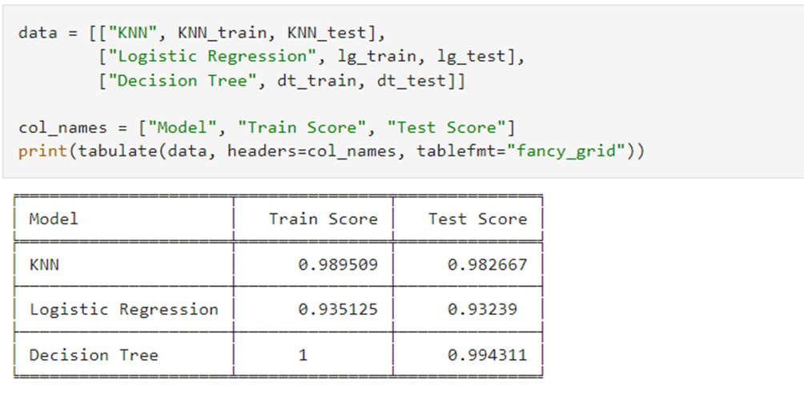

Slide 8
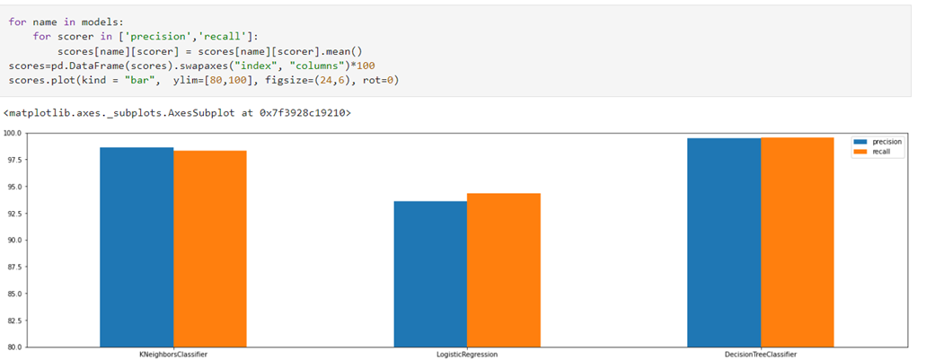

Slide 9
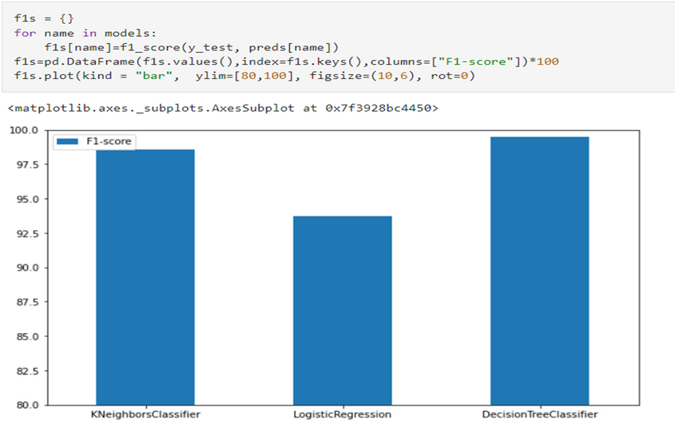
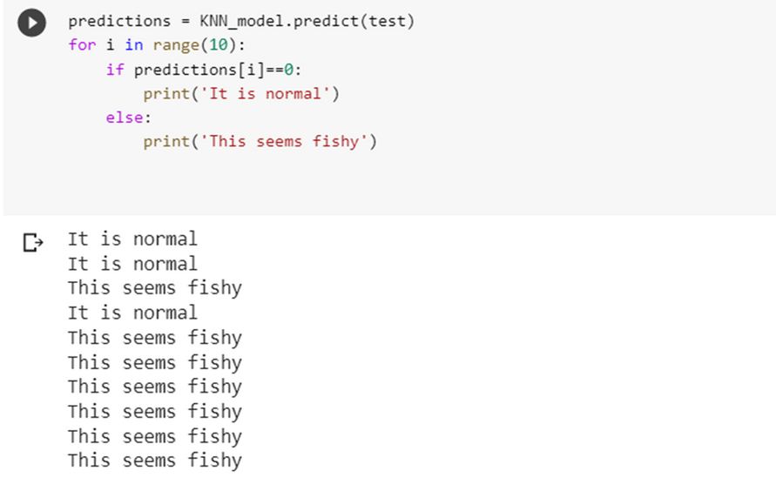

Slide 10
Limitations
Despite the promising results of this research, there are still some limitations that need to be addressed in future work.
One of the main limitations is the lack of diverse datasets that cover a wide range of attack scenarios. The data used in this study only covers a limited number of attack types, which may not be sufficient to capture the complexity and diversity of modern cyberattacks.
Another limitation is the use of a static feature selection approach, which may not be effective in dealing with highly dynamic and evolving network traffic patterns. Finally, the study only focuses on a limited number of machine learning algorithms, which may not provide the best performance in different scenarios.

Slide 11
Applications
The use of machine learning algorithms can also help in detecting previously unknown or zero-day attacks that traditional signature-based intrusion detection systems may not be able to detect. This can significantly enhance the security of a system and help in mitigating the impact of cyber attacks. The insights gained from this research can be applied to various real-world scenarios, such as securing financial institutions, government agencies, and large corporations.
One of the main advantages of using machine learning for intrusion detection is the ability to learn from past attacks and adapt to new threats. This can be especially useful in industries such as banking, healthcare, and government, where the sensitive nature of the data being transmitted requires a high level of security.

Slide 12
Conclusion
Overall, our research provides valuable insights into the potential of machine learning for network intrusion detection and offers suggestions for future research, such as the use of deep learning models like CNN and RNN, and the exploration of ensemble methods to improve the performance of machine learning models
SRI KAVI SELVAN S
URK21CO3017

Slide 13

Thank You

